Slide 1


IS4S761 Principles of Computing
Introduction to Python Programming
David Kidner (J302)
david.kidner@southwales.ac.uk
Part Two

Slide 2
Python Basics
For the time being, use the Python IDLE for your development work
There are many Python editors out there (e.g. Notepad++), but each will usually take some getting used to.
YOU will look at an alternative in another session.
Every Python programmer has a favourite editor.
In the Python IDLE, we will save all our Python programs with a .py extension.

Slide 3
Python Basics
Commenting Code (Documentation)
In python you use # as the symbol to indicate comment
Once the interpreter sees this it ignores anything on this line after the symbol while processing
This is written out for our own understanding / explanation (at a later date) and/or for other programmers
Especially if we have a neat way of doing something
Non-traditional or quirky
And also essential for your Coursework
… so you can tell me what you are doing

Slide 4
Python Basics
Commenting Code (Documentation)
We can have comments also after the command (as in line 4 above)
What happens if you put # in front of the print command?
The print command is disabled (unread or not interpreted).
The print command is one of the most important we will use. It’s useful to show results and outputs and especially for debugging
Might want to turn on/off regularly, so commenting the code out is a useful option (rather than having to type code in again).

Slide 5
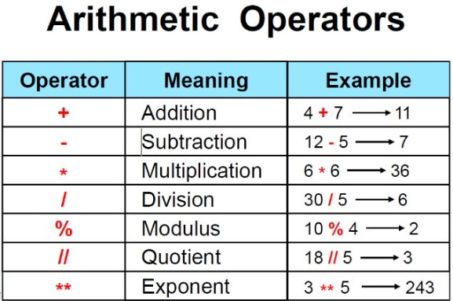
Python Basics

Slide 6
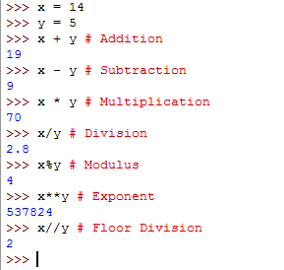
Python Basics
Arithmetic Operators in Python (with Comments)

Slide 7
Order of Operation / Operators
Python follows mathematical convention
PEMDAS –
Parenthesis
Exponential
Multiplication
Division
Addition
Subtraction

Slide 8
Order of Operation / Operators
Multiplication & division have same precedence
Addition and subtraction have same precedence
If same precedence → evaluated from left to right
Except for exponential
So use brackets to make it clear instead of trying to remember all the precedence for operators!!!
Eg: converting x minutes to seconds
4x = 4*x*60
To make it clear → 4x = (4*x)*60
The result is the same, except the second one makes it clear.
[https://docs.python.org/3/reference/expressions.html#operator-precedence]

Slide 9
Order of Operation / Operators:
Try These
>>> 5*5-1
24
>>> 5*(5-1)
20
>>> 5+5**2
30
>>> (5+5)**2
100
>>> 8/2*3+2
14.0
>>> 8/(2*3)+2
3.333333333333333
>>> 10*2/5
4.0
>>> 10/2*5
25.0
>>> 10/(2*5)
1.0
>>> 1+1*(2/3+3)+2.9*3.1+2**3
21.656666666666666

Slide 10
Python Data Types
Numbers
Boolean
String
Lists
Tuples
Dictionaries

Slide 11
Number Types
Int
Signed integers
10, -15, 3500, -080, -0x125, 0x18
Float
Floating point real values
23.3, 76.88890, 3.113e10, -90.01, -3.2e3, 5.43e-3
Complex
Complex numbers
5.3j, 567.j, 6.7e-2j, 2.3+5.6e-3j,-0.534+0j

Slide 12
Boolean
True
False
Used for comparison
AND, OR, NOT
[https://docs.python.org/3/library/stdtypes.html]

Slide 13
String
Contiguous set of characters within quotation marks
Single / double quotes
Subsets can be accessed using slice operation [ ] or [ : ]
Index always starts from zero (0) from start or
Index starts from -1 from the end

Slide 14
Strings: Try These
>>> str1 = "Hello world"
>>> print(str1[0])
H
>>> print(str1[2:5])
llo
>>> print(str1[2:])
llo world
>>> str1 = "Hello world"
>>> print(str1[-1])
d
>>> print(str1[-5:-1])
worl
>>> print(str1[-5:])
world

Slide 15
Lists and Tuples
Could be considered as arrays
They store python objects
Accessed using index (again starting from zero / end with -1)
Lists are enclosed in [ ]
Tuples are enclosed in ( )
Lists – elements and size can be changed
Tuples – is read only list
Both can have mixed data types in the same variable
Similar to strings can be used with slice operation [ ] or [ : ]

Slide 16
List – Try These
>>> templist = [1,2,3,4,5, 'abc']
>>> templist
>>> templist[2]
>>> templist[2:4]
>>> templist[2] = 10
>>> templist
>>> templist[2:4]
>>> templist = [1,2,3,4,5, 'abc']
>>> templist
[1, 2, 3, 4, 5, 'abc']
>>> templist[2]
3
>>> templist[2:4]
[3, 4]
>>> templist[2] = 10
>>> templist
[1, 2, 10, 4, 5, 'abc']
>>> templist[2:4]
[10, 4]

Slide 17
Tuples – Try These
>>> temptuples = ('qwe',2,2.3,4,5, 'abc')
>>> temptuples
[‘qwe’, 2, 2.3, 4, 5, 'abc']
>>> temptuples[2]
2.3
>>> temptuples[2:4]
[2.3, 4]
>>> temptuples[2] = 10
TypeError: 'tuple' object does not support item assignment

Slide 18
Python Basics
Variable Assignment
>>>tempint=10
>>>temp_float = 23.3
>>>text1=‘abc’
>>>text2 = “abc”
Try them in Python.
Is text1 the same as text2?

Slide 19
Python Basics: Variable Names
Usually meaningful names are given for variables
Can be any length
Can contain letters and numbers
Cannot start with a number
It’s still valid to have both upper and lower case letters
→ usually only lowercase letters are used
Underscores could be used in names
Don’t use special characters
Look at this if you want more info → https://www.python.org/dev/peps/pep-0008/#naming-conventions

Slide 20
Programming Naming Types
Lowercase → a, b, abc
Uppercase → W, X, XYZ
Lowercase with underscore → my_variable, my_var_temp
Uppercase with underscore → MY_VARIABLE, MY_STRING_OUTPUT
CamelCase → MyVariable, SetPressureValue
mixedCase → myVariable, setPressureValue
Capitalised → My_Variable, Set_Pressure_Value

Slide 21
Python Keywords
False | class | finally | is | return
None | continue | for | lambda | try
True | def | from | nonlocal | while
and | del | global | not | with
as | elif | if | or | yield
assert | else | import | pass
break | except | in | raise
cannot be used as ordinary identifiers
[https://docs.python.org/3/reference/lexical_analysis.html]

Slide 22
Valid or Not?
a
Test
str23
AStr
2strings
temperature_2
#abc
pressure$
false
a
Test
str23
AStr
2strings
temperature_2
#abc
pressure$
false

Slide 23
Basic Constructs of a Program
This Week
Input
Getting data from keyboard, a file, the network or other devices
Output
Displaying data on the screen, saving to a file, send to another device
Math
Basic mathematics like addition, multiplication
Conditional Execution
Check for certain conditions and execute the appropriate sequence of statements
Repetition
Perform some action repeatedly, usually with some variation
[Reference: http://openbookproject.net/thinkcs/python/english3e/way_of_the_program.html]
Next Time

Slide 24
Input
Easiest way to get user input is from the command line
Using the function “input”
Other ways – read files
>>> input(“Enter your name : ”)
>>>namestr = input(“Enter your name : ”)
>>>temp_int1 = input(“Enter an integer between 1 and 100 : ”)

Slide 25
What Inputs did you get?
>>> input("Enter your name : ")
Enter your name : John
‘John'
>>>namestr = input("Enter your name : ")
Enter your name : John
>>>temp_int1 = input("Enter an integer between 1 and 100 : ")
Enter an integer between 1 and 100 : 5
>>>namestr
>>>temp_int1
What happens if we type in 999 for temp_int1?

Slide 26
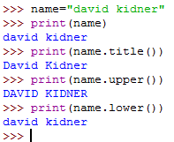
Output
We’ve already played around with the print statement in the tutorials.
>>>name=”david kidner”
>>>print(name)
>>>print(name.title())
>>>print(name.upper())
>>>print(name.lower())
We’ll look at File Input and Output in Later Exercises over the next couple of weeks.

